Slide 1
Unsigned, Offset Binary, and 2’s Complement
Assume N bits, creates array:
0
1
2
…
2^{N} – 1
Unsigned:
Array element 0 .. 2^{N} – 1 → integer value 0 .. 2^{N} – 1
Offset binary
Array element 0 .. 2^{N} – 1 → integer value -2^{N-1} .. 2^{N-1} – 1
2’s Complement
Array element 0 .. 2^{N-1} – 1 → integer value 0 .. 2^{N-1} – 1
Array element 2^{N-1} .. 2^{N} – 1 → integer value -2^{N-1} .. –1

Slide 2
Example – 8 bits
Assume 8 bits, creates array:
0
1
2
…
255
Unsigned:
Array element 0 .. 255 → integer value 0 .. 255
Offset binary
Array element 0 .. 255 → integer value -128 .. 127
2’s Complement
Array element 0 .. 127 → integer value 0 .. 127
Array element 128 .. 255 → integer value -128 .. -1

Slide 3
Example – 16 bits
Assume 16 bits, creates array:
0
1
2
…
65535
Unsigned:
Array element 0 .. 65535 → integer value 0 .. 65535
Offset binary
Array element 0 .. 65535 → integer value -32768 .. 32767
2’s Complement
Array element 0 .. 32767→ integer value 0 .. 32767
Array element 32768 .. 65535 → integer value – 32768 .. -1

Slide 4
Rounding
If i is an integer, and f is floating point then
i = (int) f
truncates toward zero.
For example:
0.0, 0.1, 0.5, 0.9 all → 0
1.0, 1.1, 1.5, 1.9 all → 1
To improve conversion accuracy do rounding:
i = (int) (f + 0.5)

Slide 5
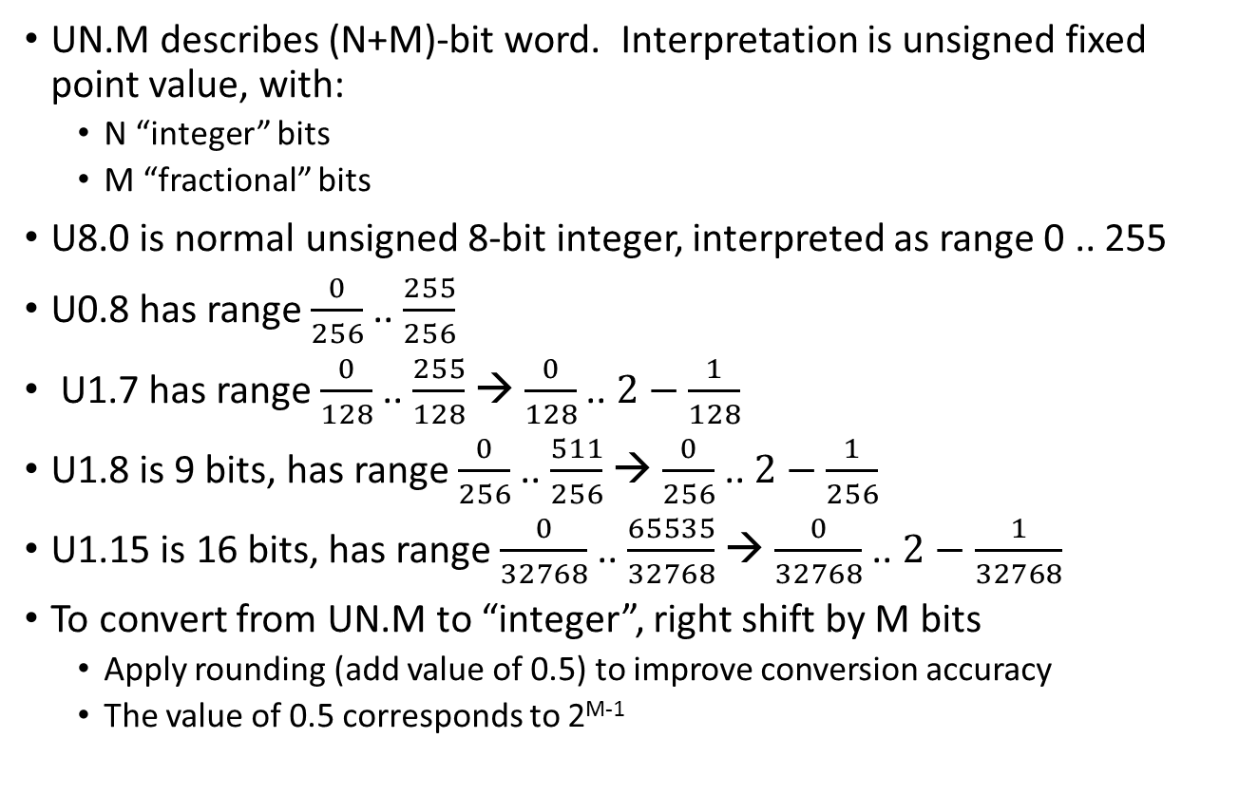
Fixed point notation: Unsigned
UN.M describes (N+M)-bit word. Interpretation is unsigned fixed point value, with:
N “integer” bits
M “fractional” bits
U8.0 is normal unsigned 8-bit integer, interpreted as range 0 .. 255
U0.8 has range $\frac{0}{256}$ .. $\frac{255}{256}$
U1.7 has range $\frac{0}{128}$ .. $\frac{255}{128}$ → $\frac{0}{128}$ .. $2−\frac{1}{128}$
U1.8 is 9 bits, has range $\frac{0}{256}$ .. $\frac{511}{256}$ → $\frac{0}{256}$ .. $2−\frac{1}{256}$
U1.15 is 16 bits, has range $\frac{0}{32768}$ .. $\frac{65535}{32768}$ → $\frac{0}{32768}$ .. $2−\frac{1}{32768}$
To convert from UN.M to “integer”, right shift by M bits
Apply rounding (add value of 0.5) to improve conversion accuracy
The value of 0.5 corresponds to 2^{M-1}

Slide 6
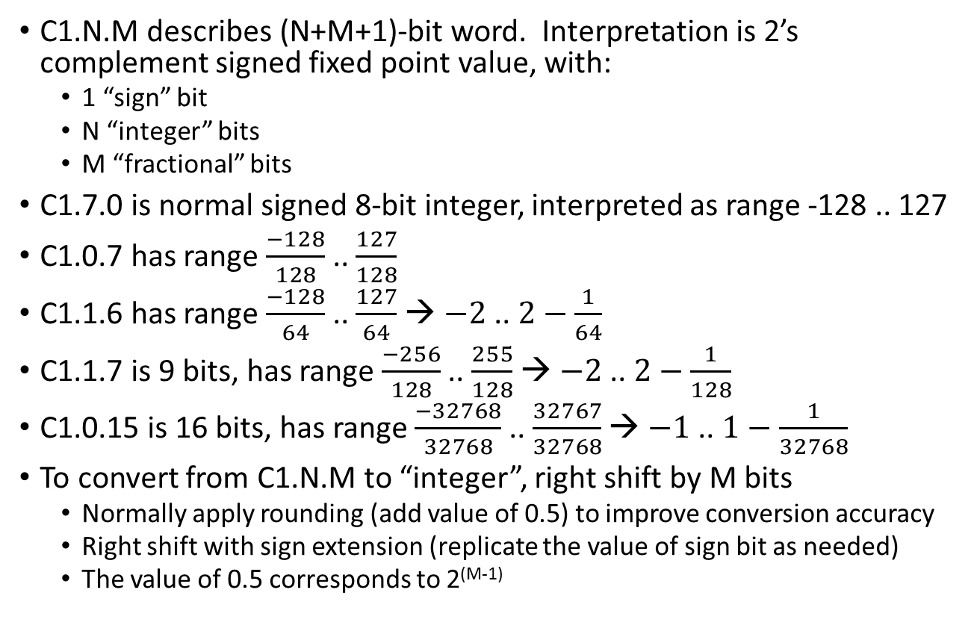
Fixed point notation: 2’s Complement
C1.N.M describes (N+M+1)-bit word. Interpretation is 2’s complement signed fixed point value, with:
1 “sign” bit
N “integer” bits
M “fractional” bits
C1.7.0 is normal signed 8-bit integer, interpreted as range -128 .. 127
C1.0.7 has range $\frac{−128}{128}$ .. $\frac{127}{128}$
C1.1.6 has range $\frac{−128}{64}$ .. $\frac{127}{64}$ → $−2$ .. $2−\frac{1}{64}$
C1.1.7 is 9 bits, has range $\frac{−256}{128}$ .. $\frac{255}{128}$ → $−2$ .. $2−\frac{1}{128}$
C1.0.15 is 16 bits, has range $\frac{−32768}{32768}$ .. $\frac{32767}{32768}$ → $−1$ .. $1−\frac{1}{32768}$
To convert from C1.N.M to “integer”, right shift by M bits
Normally apply rounding (add value of 0.5) to improve conversion accuracy
Right shift with sign extension (replicate the value of sign bit as needed)
The value of 0.5 corresponds to 2^{(M-1)}

Slide 7
Example: IIR filter
A first order IIR filter is defined by:
y(n) = a*y(n-1) + b*u(n)
Let all values be represented as C1.0.15 numbers
This is only OK if the coefficients can be less than unity (1.0)
Otherwise we’d have to add integer bits to the representation of coeffs
To do the actual computation:
#define C1_0_15_ROUND (1<<14)
int16 yn; // C1.0.15
int16 un; // C1.0.15
int16 ynm1; // C1.0.15
int16 a; // C1.0.15
int16 b; // C1.0.15
yn = (a * ynm1 + b * un + C1_0_15_ROUND) >> 15;

Slide 8
Adding fixed point numbers
Add X ~ C1.N1.M1 with Y ~ C1.N2.M2
Z = X + Y
Assume that M1 ≥ M2, N2 ≥ N1
Convert to a common fractional representation
Can right shift the value with greater fractional precision – this loses precision
Z = (X >> (M1-M2)) + Y
Z ~ C1.(N2+1).M2
Can left shift the value with lower fractional precision – this requires greater integer range
Z = (Y << (M1-M2)) + X
Z ~ C1.(N2+1).M1

Slide 9
Multiplying fixed point numbers
Multiply X ~ C1.N1.M1 with Y ~ C1.N2.M2
Z = X * Y
Z ~ C1.(N1+N2+1).(M1+M2)
Frequently N1 = N2 = 0, M1 = M2 = M, and it is desired to convert Z to C1.0.M:
Z = (X * Y) >> M
or, with rounding:
Z = (X * Y + C1_0_M_ROUND) >> M
where C1_0_M_ROUND = 1 << (M-1)

Slide 10
Examples
Multiply X ~ C1.0.15 with Y ~ C1.0.15
Z = X * Y
Z ~ C1.1.30
Often would do something like:
Z = ( (X * Y) + C1_0_15_ROUND ) >> 15
Note that the only case where the integer part of the product is non zero is where -1.0 * -1.0 = +1.0

Slide 11
Saturating fixed point numbers
Often it is necessary to reduce the number of integer bits, e.g. convert
C1.1.30 to C1.0.30
C1.16.15 to C1.0.15
This is typically done with saturation:
if (z > MAX_DST) z = MAX_DST;
if (z < MIN_DST) z = MIN_DST;
Example, convert C1.16.15 to C1.0.15
#define MAX_DST = ( (1 << 15) – 1 )
#define MIN_DST = ( -(1 << 15) )

